Slide 1


COSMETIC RECOMMENDATION SYSTEM BASED ON INGREDIENTS USING COSINE SIMILARITY

Slide 2




OUR TEAM
Sekar Alisha Firdaus
Raina Imtiyaz
Laksmi Dwi Nurmuthia

Slide 3

TABLE OF CONTENT
01
04
Background
Methodology
02
05
Problems
Results and Discussion
03
06
Objectives
Conclusion

Slide 4
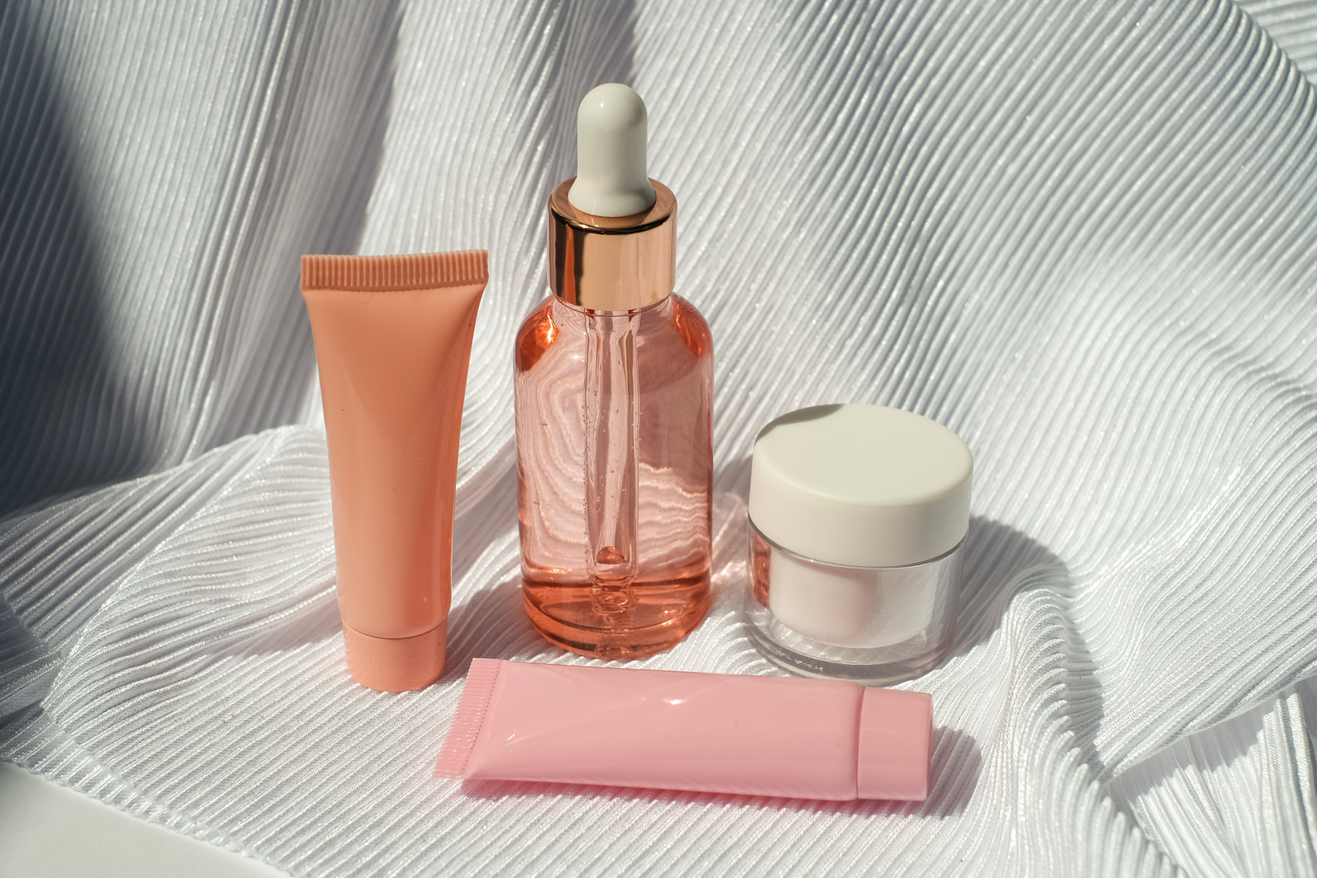
BACKGROUND
Skincare has become a frequent topic of discussion lately, among both women and men. There are numerous skincare brands offering a wide range of products for personal care. When people decide to purchase skincare items, they naturally focus on the product's ingredients and its functions. However, due to the sheer variety of products and brands available, individuals often find it challenging to make a choice.

Slide 5

PROBLEMS
Due to the sheer variety of products and brands available, individuals often find it challenging to make a choice. Moreover, making the wrong choice can have adverse effects on the skin, including irritation, breakouts, or allergies. Therefore, there is a need for a way to assist people in finding skincare products that suit their skin types without difficulty

Slide 6


OBJECTIVES
To solve the complex challenges in skincare through the application of cosine similarity in recommendation systems .
This approach combines cosine similarity technology with current dermatology principles to develop a skincare recommendation system based on skin type and skin concerns. This research also delves into the theoretical field of dermatology by formulating and testing new theories based on in-depth data analysis.

Slide 7
Data Collection and Preprocessing
Label Segmentation
METHODOLOGY
Document Term Matrix (DTM) Creation
Cosine Similarity Calculation
Product Recommendation

Slide 8
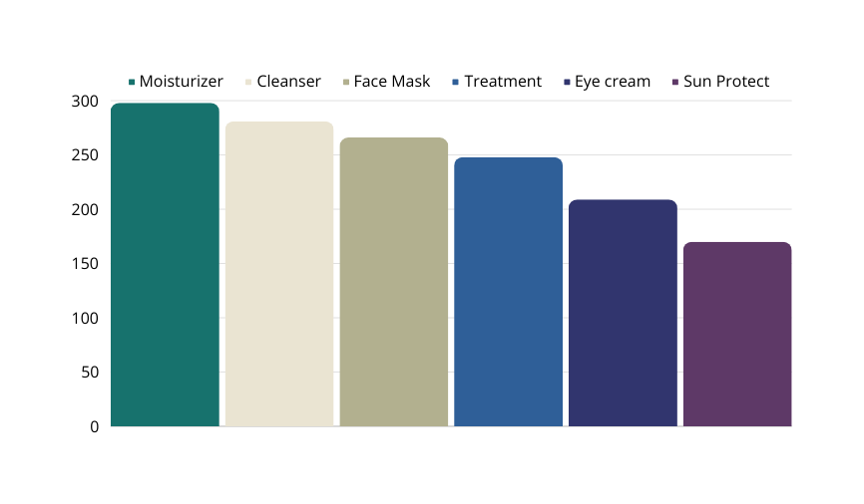
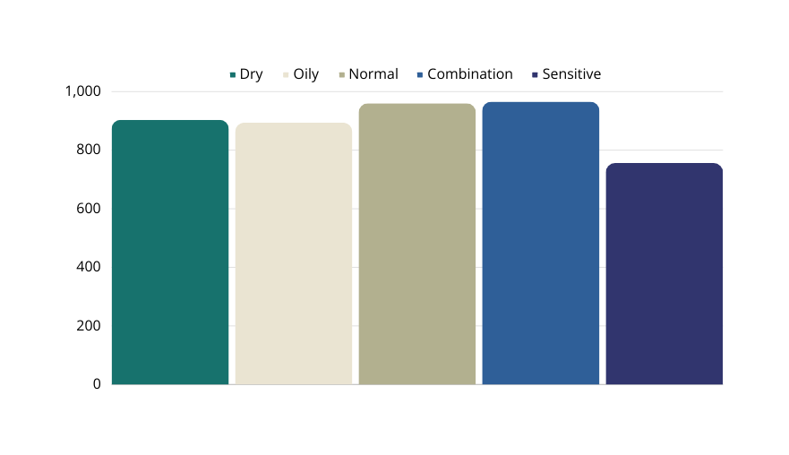
DATA COLLECTION AND PREPROCESSING
In this paper, the data is taken from Kaggle. The dataset is a cosmetic dataset. This dataset contains information about whether a product is suitable for a particular skin type. The data from this dataset is collected from Sephora and the total of products is 1472 products. This dataset has eleven columns. These columns consist of the type of product, brand of product, name of cosmetic, price, ranking, ingredients, and whether the product suits dry, normal, oily, or combination skin.

Slide 9
LABEL SEGMENTATION
DTM CREATION
To facilitate the calculation of cosine similarity, a document term matrix is created for each combination of skincare label and skin type. A document term matrix was created for each combination of skincare label and skin type to represent the presence or absence of certain ingredients. Each ingredient is assigned a unique index for efficient representation within the matrix. The resulting DTM serves as input to the cosine similarity calculation.
The data is segmented into specific skincare labels such as moisturizer, cleanser, face mask, treatment, eye cream, and sun protect. Each label is further categorized according to different skin types, such as dry skin, normal skin, combination skin, oily skin, and sensitive skin. This segmentation allows detailed analysis of ingredients based on specific product categories and skin types.

Slide 10
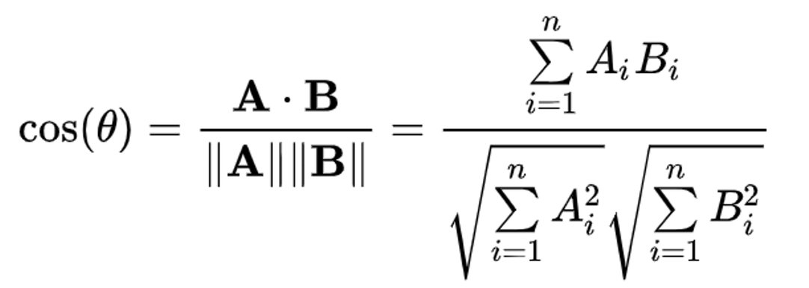
COSINE SIMILARITY
Cosine similarity is a way to measure the similarity between one vector and another vector. Cosine similarity measures the angle between these two vectors. Cosine similarity was calculated based on the ingredients of different cosmetic products, allowing to identify products with similar ingredient compositions.

Slide 11

PRODUCT RECOMMENDATION
Product recommendation algorithm has been developed that suggests cosmetics based on the purchased item/s. The algorithm considered the skincare label, skin type, and ingredient. Given a specific product type, skin type, and purchased product as an input, the algorithm calculated cosine similarity to other products and recommend the most similar product, excluding the purchased product itself.

Slide 12

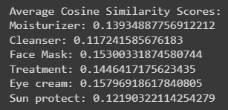
RESULT AND DISCUSSION
The cosine similarity analysis reveals product similarity across skincare categories, with higher scores indicating greater resemblance in ingredient compositions. Higher scores suggest potential clustering, while an average cosine similarity score provides a comprehensive picture.

Slide 13
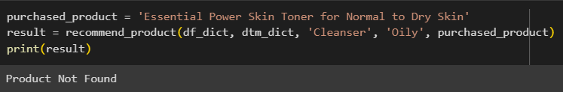
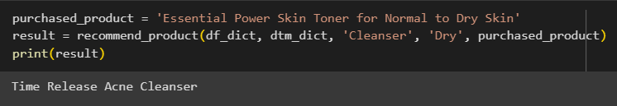
RESULT AND DISCUSSION
This system uses inputs like skincare categories, skin types, and purchased products to provide skincare recommendations. The system selects products based on the second highest cosine similarity value, as the first is the purchased product. However, the system sometimes returns 'Product Not Found' messages due to insufficient data. This recommendation helps users find products with similar ingredients when frequently purchased products are out of stock or discontinued.

Slide 14
CONCLUSION
This research explores the use of cosine similarity in creating a skincare recommendation system that considers skincare label and skin type. It offers valuable insights into inter-product relationships within the skincare segment and quantifies ingredient similarity. The study benefits consumers by helping them choose effective skincare products and has implications for the beauty industry and software developers. Related works have explored techniques like deep learning, t-SNE algorithm, YOLOv4 algorithm, Simple Additive Weighting method, image recommendation, speech recognition, text mining, and time series data prediction. Future research could expand the model to include price and discounts, enhancing user satisfaction and product sales.

Slide 15
THANK YOU
FOR YOUR NICE ATTENTION

